Slide 1
Electrical Circuits
EEE-281 Lecture Notes
Dr. Özçel Cangül
Lecture Notes by Dr. Ali Muhtaroğlu
Fall 2023
METU Northern Cyprus Campus
References:
Electric Circuits 10th Ed. by Nilsson & Riedel
Electrical Circuit Analysis 3rd Ed. by Johnson, Johnson, Hilburn, and Scott
Engineering Circuit Analysis 7th Ed. by Hayt, Kemmerly, and Durbin
Fundamentals of Electric Circuits 3rd Ed. by Alexander, and Sadiku

Slide 2
Simple Resistive Circuits
Weeks 4-5
Reading: Nilsson & Riedel Chapter 3
Ali Muhtaroğlu

Slide 3
Subcircuit Equivalence
Any two-terminal subcircuit (portion of a circuit) has a terminal law that relates terminal v and i.
            Terminal Law for a ...
              ... resistor:
              ... independent Voltage Source:
              ... independent Current Source:
              etc.
terminal i
+
terminal v
-
Ali Muhtaroğlu

Slide 4
Subcircuit Equivalence
Any two-terminal subcircuit (portion of a circuit) has a terminal law that relates terminal v and i.
            Terminal Law for a ...
              ... resistor: v=f(i)=R.i or i=g(v)=G.v
              ... independent Voltage Source: v=v_{s}
              ... independent Current Source: i=i_{s}
              etc.
terminal i
+
terminal v
-
Ali Muhtaroğlu

Slide 5
Subcircuit Equivalence
Any two-terminal subcircuit (portion of a circuit) has a terminal law that relates terminal v and i.
            Terminal Law for a ...
              ... resistor: v=f(i)=R.i or i=g(v)=G.v
              ... independent Voltage Source: v=v_{s}
              ... independent Current Source: i=i_{s}
              etc.
Using simpler equivalent circuits to replace the more complex ones saves time and resources in circuit analysis.
The above test will be applied to check equivalence.
terminal i
+
terminal v
-
2 two-terminal subcircuits are equivalent if they have
the same terminal law.
Ali Muhtaroğlu

Slide 6
Series Equivalents
Two adjacent elements are in series if they share a common node that has no other currents entering it. Nonadjacent elements are in series if they are each in series with the same element.
Ali Muhtaroğlu

Slide 7
Series Equivalents
Two adjacent elements are in series if they share a common node that has no other currents entering it. Nonadjacent elements are in series if they are each in series with the same element.
Using KVL and Ohm’s Law:
Therefore, equivalence is maintained if the resistors are replaced by a single equivalent resistance:
In general for N series resistors:
Ali Muhtaroğlu

Slide 8
Series Equivalents
A chain of series resistors is equivalent to a single
resistor whose resistance is the sum of the series resistances.
≡
Ali Muhtaroğlu

Slide 9
Voltage Division
A chain of series resistors is equivalent to a single
resistor whose resistance is the sum of the series resistances.
Principle of Voltage Division:
Similarly:
≡
The voltage across series resistors divides up in direct proportion to their resistances. Such a circuit is called a voltage divider.
Ali Muhtaroğlu

Slide 10
Example 2
Johnson & Johnson Exercise 2.4.1 (Page 42)
Reduce the below circuit to two equivalent elements, and find i and the instantaneous power dissipated by the 50 V source.
Ali Muhtaroğlu

Slide 11
Example 2
Johnson & Johnson Exercise 2.4.1 (Page 42)
Reduce the below circuit to two equivalent elements, and find i and the instantaneous power dissipated by the 50 V source.
≡
Solution
KVL:
Since looking for power dissipated, i needs to enter the positive terminal:
Ali Muhtaroğlu

Slide 12
Parallel Equivalents
Two elements are in parallel if they form a loop containing no other elements. Elements in parallel all have the same voltage across them.
Node A
Ali Muhtaroğlu

Slide 13
Parallel Equivalents
Two elements are in parallel if they form a loop containing no other elements. Elements in parallel all have the same voltage across them.
Node A
≡
KCL at Node A & Ohm’s Law:
The equivalent circuit has the terminal law:
Hence,
In general for N parallel resistors:
Ali Muhtaroğlu

Slide 14
Equivalent Resistance of 2 Parallel Resistors
The equivalent resistance of two resistors in parallel is the product of their resistances divided by the sum.
[This rule ONLY applies to 2 parallel resistors!]
≡
For N=2,
Only for N=2:
Ali Muhtaroğlu

Slide 15
Principle of Current Division
Node A
≡
Ohm’s Law:
Similarly:
The current through parallel resistors divides up in direct proportion to their conductances and inverse proportion to their resistances. Such a circuit is called a current divider.
Ali Muhtaroğlu

Slide 16
Example
Find i₁ through i₅ in the following circuit:
Ali Muhtaroğlu

Slide 17
Example
Find i₁ through i₅ in the following circuit:
Solution:
Using current divider:
(1)
(2)
Ohm’s Law:
From (2):
KCL:
From (1):
KCL:
Ali Muhtaroğlu

Slide 18
Example based on N & R Problem 3.5
Find the equivalent resistance seen by the source in the following circuit. Calculate v.
Ali Muhtaroğlu

Slide 19
Example based on N & R Problem 3.5
Find the equivalent resistance seen by the source in the following circuit. Calculate v.
Solution:
Ali Muhtaroğlu

Slide 20
Example based on N & R Problem 3.5
Find the equivalent resistance seen by the source in the following circuit. Calculate v.
Solution:
Ali Muhtaroğlu

Slide 21
Example based on N & R Problem 3.5
Find the equivalent resistance seen by the source in the following circuit. Calculate v.
Solution:
Ali Muhtaroğlu

Slide 22
Example based on N & R Problem 3.5
Find the equivalent resistance seen by the source in the following circuit. Calculate v.
Solution:
So R_{eq} = 6 kΩ
And using Ohm’s Law:
v = 2m.6k = 12 V
Ali Muhtaroğlu

Slide 23
Example based on N & R Problem 3.5
Find the equivalent resistance seen by the source in the following circuit. Calculate i.
Ali Muhtaroğlu

Slide 24
Example based on N & R Problem 3.5
Find the equivalent resistance seen by the source in the following circuit. Calculate i.
Solution:
Ali Muhtaroğlu

Slide 25
Example based on N & R Problem 3.5
Find the equivalent resistance seen by the source in the following circuit. Calculate i.
Solution:
Ali Muhtaroğlu

Slide 26
Example based on N & R Problem 3.5
Find the equivalent resistance seen by the source in the following circuit. Calculate i.
Solution:
So R_{eq} = 50 Ω
And using Ohm’s Law:
i = -50 V / 50 Ω = -1 A
Ali Muhtaroğlu

Slide 27
Measurement Devices
An ideal measurement device does not disturb the circuit it is validating.
Ammeter: Measures the current flowing through its terminals. An ideal Ammeter has zero voltage drop across it (low impedance). It gets connected in series with the component it is trying to characterize.
Ali Muhtaroğlu

Slide 28
Measurement Devices
An ideal measurement device does not disturb the circuit it is validating.
Ammeter: Measures the current flowing through its terminals. An ideal Ammeter has zero voltage drop across it (low impedance). It gets connected in series with the component it is trying to characterize.
Voltmeter: Measures the voltage across its terminals. An ideal Voltmeter has a terminal current of zero (high impedance). It gets connected in parallel to the component it is trying to characterize.
Ali Muhtaroğlu

Slide 29
Measurement Devices
An ideal measurement device does not disturb the circuit it is validating.
Ammeter: Measures the current flowing through its terminals. An ideal Ammeter has zero voltage drop across it (low impedance). It gets connected in series with the component it is trying to characterize.
Voltmeter: Measures the voltage across its terminals. An ideal Voltmeter has a terminal current of zero (high impedance). It gets connected in parallel to the component it is trying to characterize.
Ohmmeter: Measures resistance connected between its terminals. An ideal Ohmmeter delivers zero power to the resistance it is measuring. It gets connected in parallel to the component it is trying to characterize. Remember to turn off power in the circuit when characterizing resistance.
Ali Muhtaroğlu

Slide 30
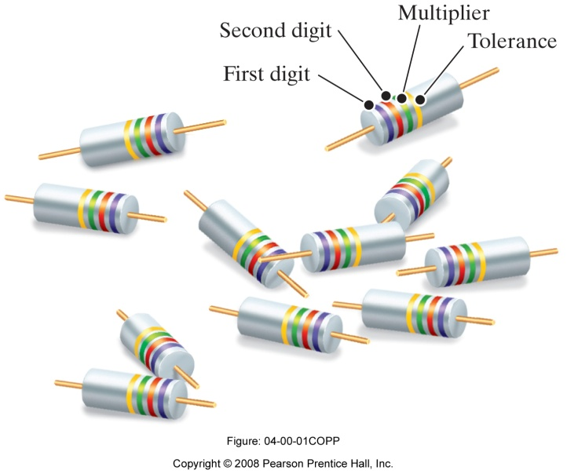
Color Code For Carbon Resistors
Every component has a tolerance. Good designs can tolerate variations !
It is a good practice to verify specifications empirically before using components to better match modeling/hand-analysis/simulations and the actual results obtained from the design. [Will be doing some of this in Lab 1.]
4-band-code:
a
b
c
% tolerance
Ali Muhtaroğlu

Slide 31
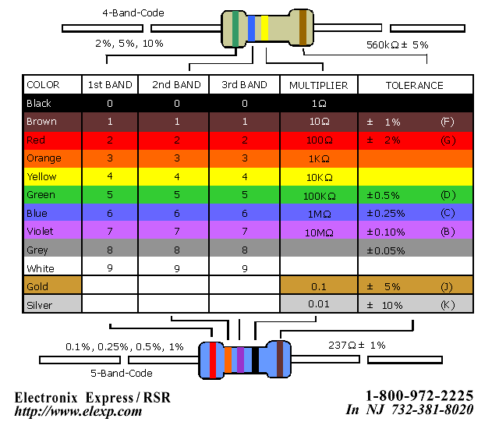
Color Code For Carbon Resistors
$$R=\left(100a+10b+c\right)∙{10}^{d}±\%tolerance$$
Ali Muhtaroğlu

Slide 32
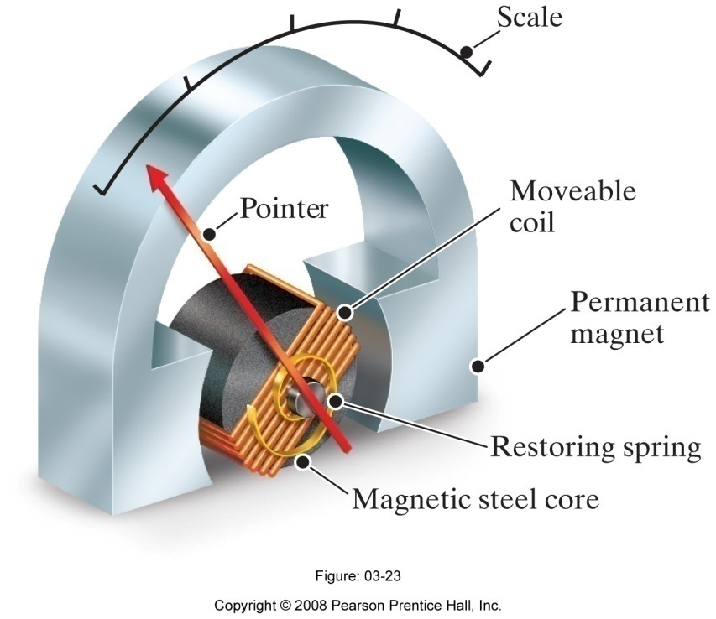
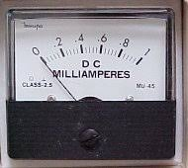
More on Measurement Devices
Readout in Analog Meters (d’Arsonval meter): Current in coil creates torque under the magnetic field, causing it to rotate together with an attached pointer across a calibrated scale. A sample commercial rating is 50mV at 1mA. This means when the coil carries 1mA, it is deflected to full scale position and has a voltage drop of 50mV.
Ali Muhtaroğlu

Slide 33
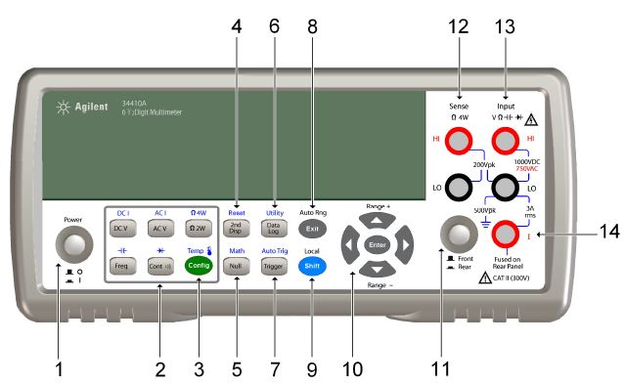
More on Measurement Devices
Readout in Analog Meters (d’Arsonval meter): Current in coil creates torque under the magnetic field, causing it to rotate together with an attached pointer across a calibrated scale. A sample commercial rating is 50mV at 1mA. This means when the coil carries 1mA, it is deflected to full scale position and has a voltage drop of 50mV.
Digital Meters: Measure analog signals at discrete points in time (sampling) and convert to digital form. They in general have less resistance than the analog meters, are easier to connect, and have higher precision due to the readout mechanism (what we have in the lab).
Ali Muhtaroğlu

Slide 34
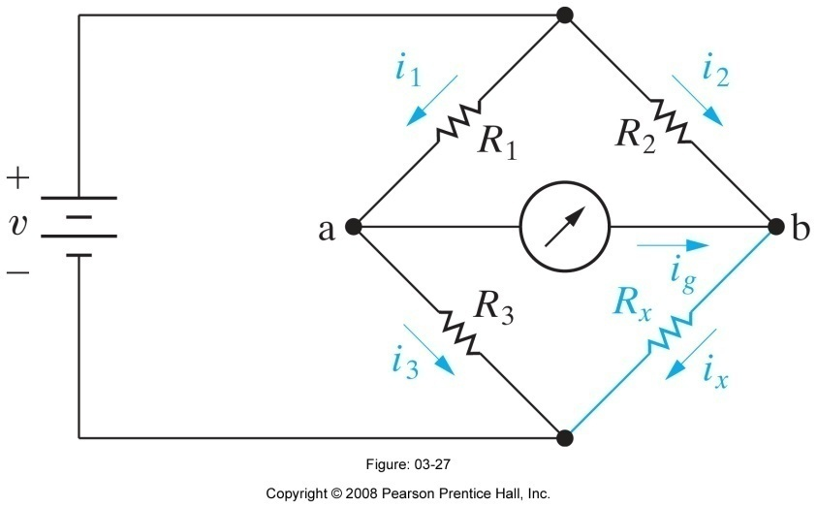
Resistance Measurement through Wheatstone Bridge
Resistor
under test
Ali Muhtaroğlu

Slide 35
Resistance Measurement through Wheatstone Bridge
Adjust R₃ until i_{g}=0 as measured by the galvanometer (ammeter) in the center.
KCL:
KVL:
Resistor
under test
Substitute for i₃ from (1) and i₂ from (2) into (3) to get:
Divide (5) by (4):
Therefore, a wide range of R_{x} values can be measured by making R₂/R₁ coarsely adjustable and R₃ finely adjustable.
Normally R₂/R₁ can be varied between 0.001 to 1000 with 10x steps.
R₃ is adjustable between 1 Ω to 11,000 Ω.
Ali Muhtaroğlu

Slide 36
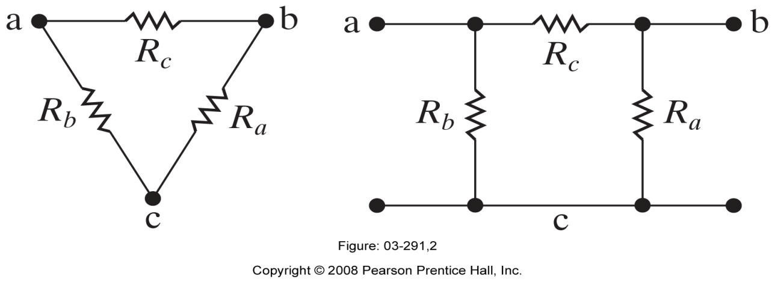
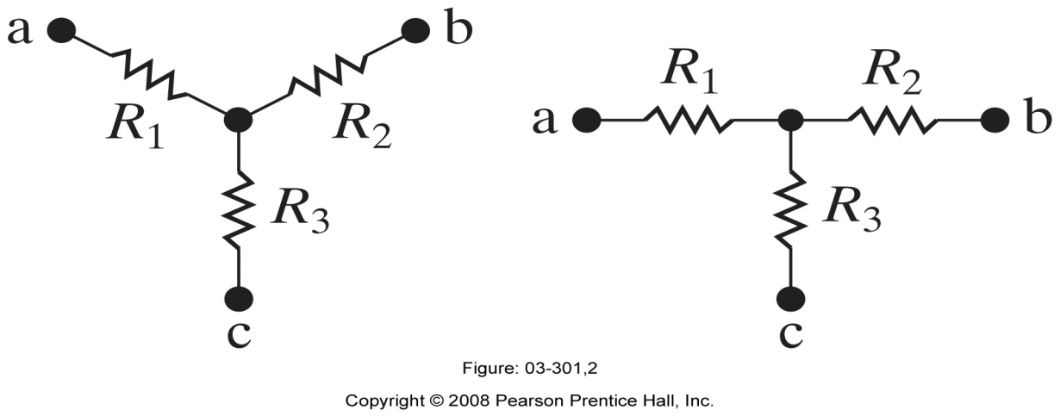
Delta-to-Wye (Pi-to-Tee) Equivalent Circuits
The following electrical networks come up in many fields of electrical engineering. They are most common in Power Engineering and Machine modeling.
Delta (Δ) Interconnection ≡ Pi (π) Interconnection
≡
Wye (Y) Interconnection ≡ Tee (T) Interconnection
≡
Ali Muhtaroğlu

Slide 37
Delta-to-Whye (Pi-to-Tee) Equivalent Circuits
The following electrical networks come up in many fields of electrical engineering. They are most common in Power Engineering and Machine modeling.
Delta (Δ) Interconnection ≡ Pi (π) Interconnection
≡
How do we go from one to the other?
Wye (Y) Interconnection ≡ Tee (T) Interconnection
≡
Ali Muhtaroğlu

Slide 38
Δ-to-Y Transformation
To achieve equivalence, need:
Resistance between terminals a-b (R_{ab}) in Δ-connected circuit
= Resistance between terminals a-b in Y-connected circuit
… and the same for the other terminals…
Observing parallel and series resistances in the previous page:
Manipulating:
Ali Muhtaroğlu

Slide 39
Δ-to-Y Transformation
To achieve equivalence, need:
Resistance between terminals a-b (R_{ab}) in Δ-connected circuit
= Resistance between terminals a-b in Y-connected circuit
… and the same for the other terminals…
Observing parallel and series resistances in the previous page:
Manipulating:
Again manipulating the original equations above:
Y-to- Δ Transformation
Ali Muhtaroğlu

Slide 40
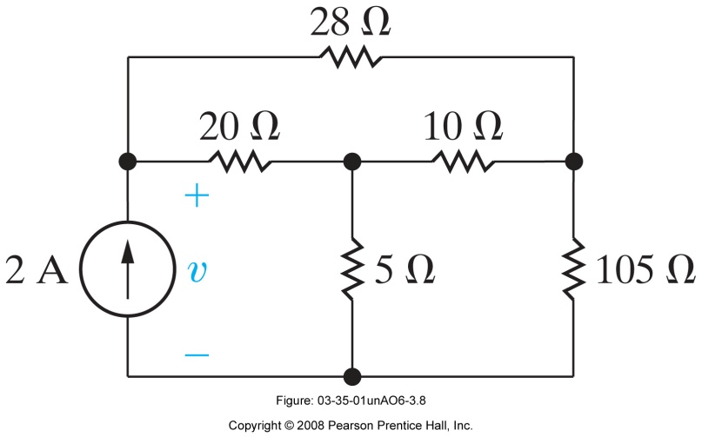
Example (N & R AP 3.8)
Use a Y-to-Δ transformation to find the voltage v in the following circuit:
Ali Muhtaroğlu

Slide 41
Example (N & R AP 3.8)
Use a Y-to-Δ transformation to find the voltage v in the following circuit:
Equivalent circuit:
Solution:
Ali Muhtaroğlu

Slide 42
Example (N & R AP 3.8)
Use a Y-to-Δ transformation to find the voltage v in the following circuit:
Equivalent circuit:
Solution:
Ali Muhtaroğlu

Slide 43
RMS Value
Definition: RMS (Root Mean Square)
I_{DC}
RMS value of an AC current is the value of DC current that would dissipate the same amount of power as the AC current on a resistance R
+
+
The above definition is based on the principle of equating the heating effects of the currents calculated in both cases.
First, calculate the power dissipated (heating effect) in the resistance R in the DC circuit shown on the RHS:
V_{R}
V_{DC}
R
_
V_{R} = R x I_{DC}
P_{DC} = V_{R} x I_{DC}
= R x I_{DC}²
Ali Muhtaroğlu

Slide 44
RMS Value
RMS (Root Mean Square)
I(t) = I_{max} sin wt
I ²(t) = (I_{max} sin wt )²
Now, calculate the power dissipated (the heating effect) in the resistance R in the AC circuit shown below:
2.5
2.0
V_{R} (t) = I(t) x R
P_{AC} (t) = V(t) x I(t)
= R I(t)² = R ((V_{max} / R) sin wt )²
= R (I _{max} sin wt )²
1.5
1.0
0.5
Angle (Radians)
0
π
I(t) = (V_{max} / R) sin wt
I(t)
0
π/2
3π/2
2π
V(t)
+
-0.5
+
I_{max}
V_{R}(t)
R
-1.0
_
-1.5
V(t) = V_{max} sin wt
-2.0
Ali Muhtaroğlu

Slide 45
RMS Value
Definition
Now let us equate the power dissipations in the above cases
V_{R} = R x I_{DC}
P_{DC} = V_{R} x I_{DC}
= R x I_{DC}²
I_{DC}
+
+
V_{DC}
V_{R}
R
V_{R} (t) = R x I(t)
P_{AC} (t) = V(t) x I(t)
= R I(t)² = R ((V_{max} / R) sin wt )²
= R (I _{max} sin wt )²
_
I(t) = (V_{max} / R) sin wt
I(t)
V(t)
+
+
I_{max}
V(t)
R
_
V(t) = V_{max} sin wt
Ali Muhtaroğlu

Slide 46
RMS Value
Definition
I²(t) = ( I_{max} sin wt )²
I_{rms} = √ ( 1/T ) ∫ I(t)² dt
RMS value of an AC current is the value of DC current that would dissipate the same amount of power as AC current on a resistance R
2.5
2.0
P_{avg} = R I_{DC}²
=
P_{avg} = R I_{rms}²
1.5
1.0
I_{DC}
I(t)
V_{DC}
+
+
V(t)
+
+
0.5
V_{R}
R
V_{R}(t)
R
_
_
0
π
0
π/2
3π/2
2π
Angle (Radians)
Ali Muhtaroğlu

Slide 47
RMS Value
For a sinusoidal signal, RMS value simplifies to: Amplitude/2^{1/2}
Definition
I²(t) = ( I_{max} sin wt )²
I_{rms} = √ ( 1/T ) ∫ I(t)² dt
RMS value of an AC current is the value of DC current that would dissipate the same amount of power as AC current on a resistance R
2.5
2.0
P_{avg} = R I_{DC}²
=
P_{avg} = R I_{rms}²
1.5
1.0
I_{DC}
I(t)
V_{DC}
+
+
V(t)
+
+
0.5
V_{R}
R
V_{R}(t)
R
_
_
0
π
0
π/2
3π/2
2π
Angle (Radians)
Ali Muhtaroğlu

Slide 48
RMS Value of a Sinusoidal Waveform
Problem
Voltage (Volts)
312
Calculate the RMS value of the sinusoidal voltage waveform with 312 Volts peak value as shown
220
V_{rms} = 220 Volts
Angle (Radians)
0
π/2
π
3π/2
2π
- 312
Ali Muhtaroğlu

Slide 49
RMS Value of a Sinusoidal Waveform
Problem
Voltage (Volts)
312
Calculate the RMS value of the sinusoidal voltage waveform with 312 Volts peak value as shown
220
V_{rms} = 220 Volts
V_{rms} = V_{max} / 2^{1/2}
= V _{max} x 0.7071
= 312 x 0.7071 = 220 Volts
Angle (Radians)
0
π/2
π
3π/2
2π
- 312
Domestic rms voltage level in Turkey
Ali Muhtaroğlu

